Slide 1



SOFTWARE DEVELOPMENT PROFESSIONAL PROGRAM
Introduction to Forms

Slide 2





Introduction to Forms
Learning Objectives
Use a variety of different form input types.
Create forms that use the HTTP verbs GET and POST.
Describe the differences in how form data is passed when using the GET vs. POST method.

Slide 3

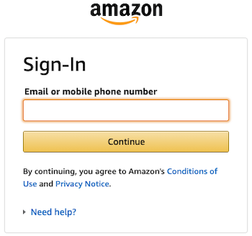
Introduction to Forms
What Are Forms?
You've likely seen many forms.
As web developers, we use forms to collect information from our users.
Source: Amazon.com
Notes:
What is your experience with forms? Let's discuss the good, the bad, and the ugly.
Which sites have forms that are particularly nice or terrible?
What do you think of Amazon's login?

Slide 4
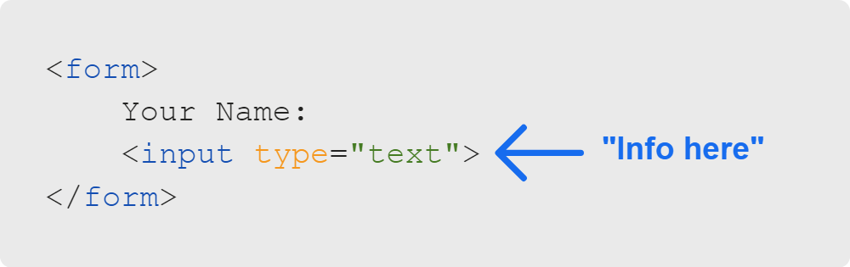
Introduction to Forms
Forms & Input Tags
Here is the visual result:
Notes:
A "form" tag is a container for your input fields. It groups the input fields together to submit them when
the user is finished entering information.
An "input" tag is where the actual information goes. In this case, the information is being gathered by a
textbox.

Slide 5


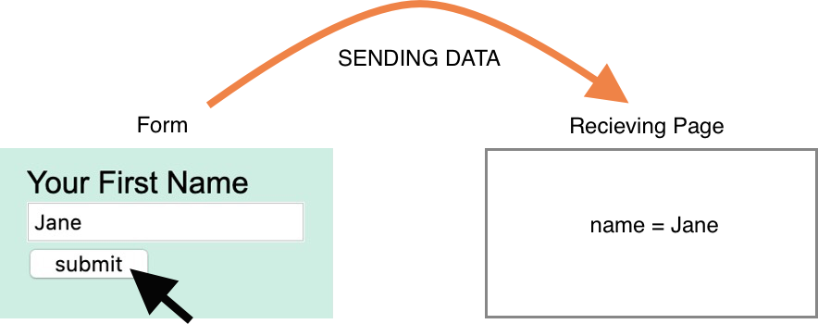
Introduction to Forms
Form Attributes: Action & Method
Action: Where the form sends data
Method: GET (default) or POST
Both methods transfer data from the client to the server in the HTTP protocol.
However, GET carries a request parameter added in the URL string making it a security risk because the data is exposed in the URL bar. POST is secure because it’s not rendered in the URL bar.
Notes:
The "method" attribute has only two possible values: "GET" and "POST." This refers to the HTTP verb that
will be used for making the request.
Note: If you misspell "POST" or put "FOOBAR" for the "method" attribute, you'll have a "GET" request instead.
<< Refer to LC exercise 1: Form Tags >>

Slide 6
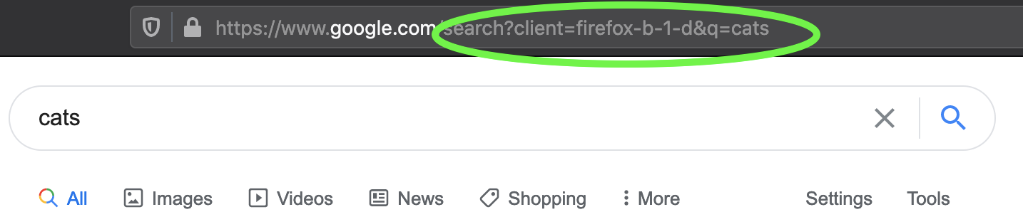
Introduction to Forms
The GET Method
The GET method passes data in the URL's query string.
The query string is the set of key-value pairs that comes after the ? in a URL.
Notes:
This image shows the result of typing "cats" into a Google search on a Firefox developer browser.
Search queries are common uses of "GET" requests. They fetch data but never modify it.

Slide 7

Introduction to Forms
HTTP Verbs: GET & POST
GET
POST
Data visible in URL
Data size restrictions
Only for requesting data
Data not visible in URL
No data size restrictions
Used for modifying/adding data
Notes:
With "GET," data entered into the form is passed as part of the URL's query string.
With "POST," data entered into the form is encrypted and passed with the request.

Slide 8
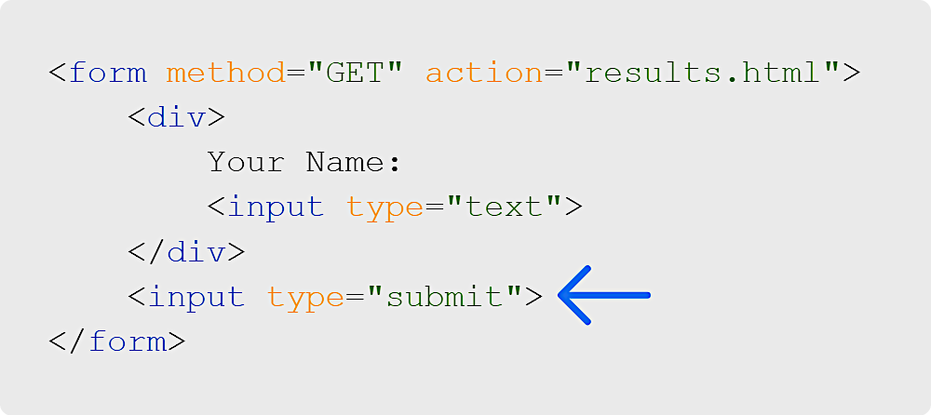
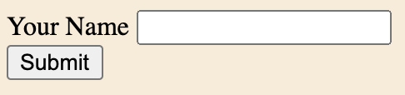
Introduction to Forms
Submit Buttons
Notes:
Forms aren't much fun without a way to make them work. Let's add a submit button.
<< Refer to LC exercise 2: Submit Buttons >>

Slide 9
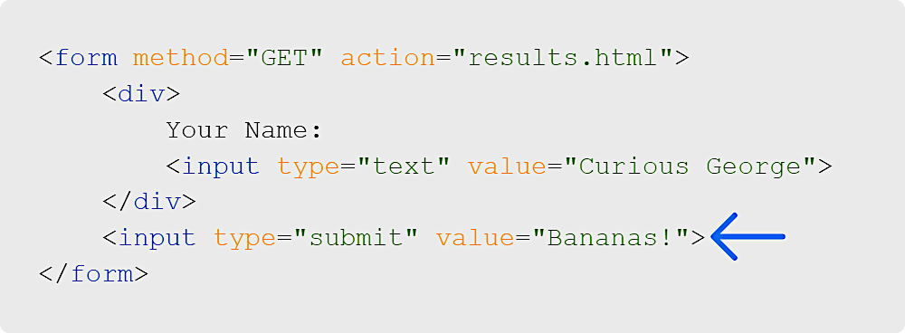
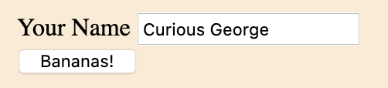
Introduction to Forms
Input Values
Notes:
Depending on the type, input tags have different attributes that can be added.
For example, the "value" attribute changes the textbox content with type="text"
It also can change the button text with type="submit" or type="button"
<< Refer to LC exercise 3: Submit Button Text >>

Slide 10
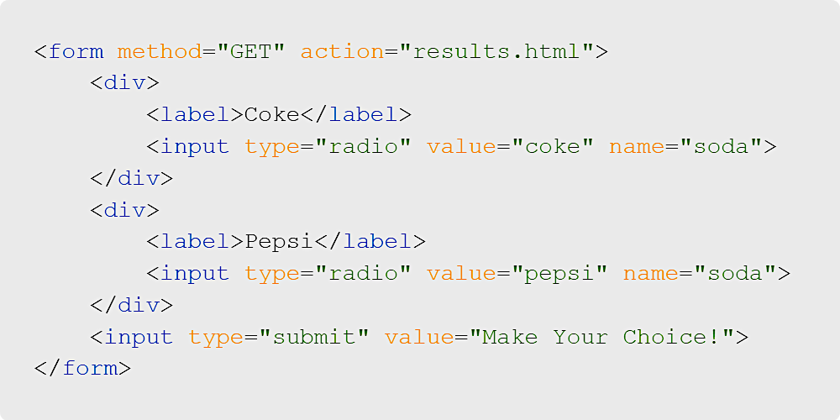
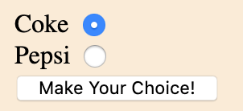
Introduction to Forms
Radio Buttons
Notes:
The "name" attribute helps you track which piece of data you're gathering.
Radio buttons are grouped by the "name" attribute. This is how you know that both Coke and Pepsi
are part of the "soda" group and that only one should be selected at a time.

Slide 11
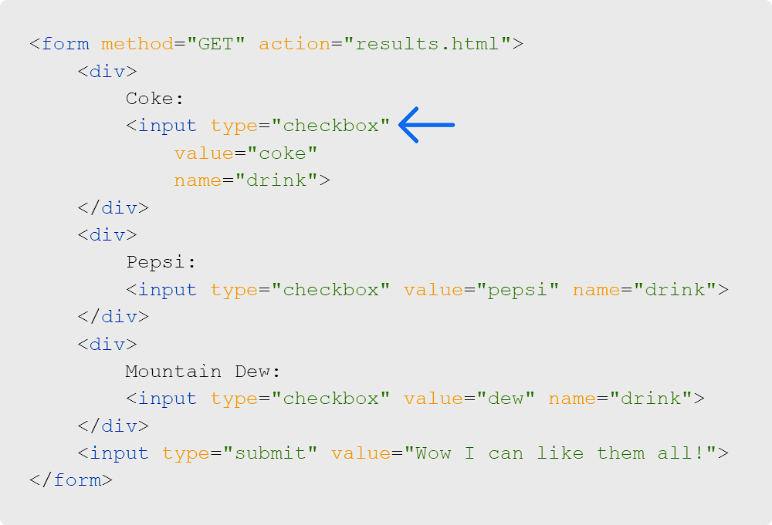
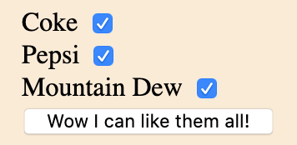
Introduction to Forms
Checkboxes
Notes:
Let's discuss: Where have you seen a radio button or checkbox input? What type of data is collected?
Checkboxes are grouped by the "name" attribute in the same way radio buttons are. Unlike
radio buttons, checkboxes can select any number of options at the same time.

Slide 12
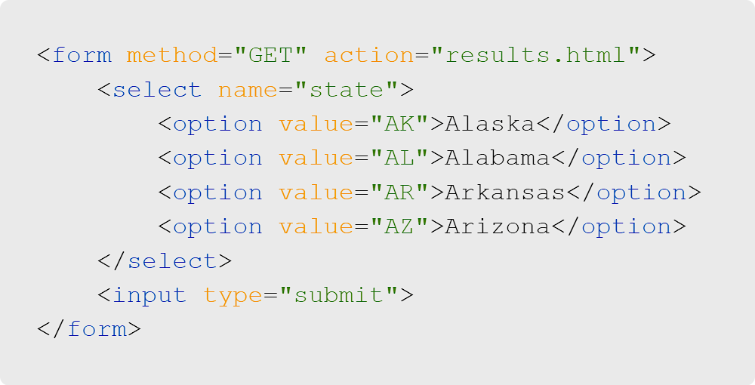
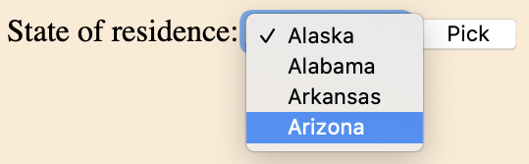
Introduction to Forms
Dropdown Lists
Notes:
Dropdowns are not implemented as "input" tags but as "select" tags. Each option in a dropdown
is added with an "option" tag. The "name" attribute tracks what data is gathered.

Slide 13
Introduction to Forms
More Input Types
Many other input types exist, including:
Format-specific (URL, email, number, etc.)
Password (hidden characters)
Date (may have date-picker support)
Color (may have color-picker support)
Button (for uses other than submit)
File (for uploading files)
Check out the list from W3Schools.
Notes:
Open the W3Schools list in a new tab, scroll down, and demo different input types.

Slide 14

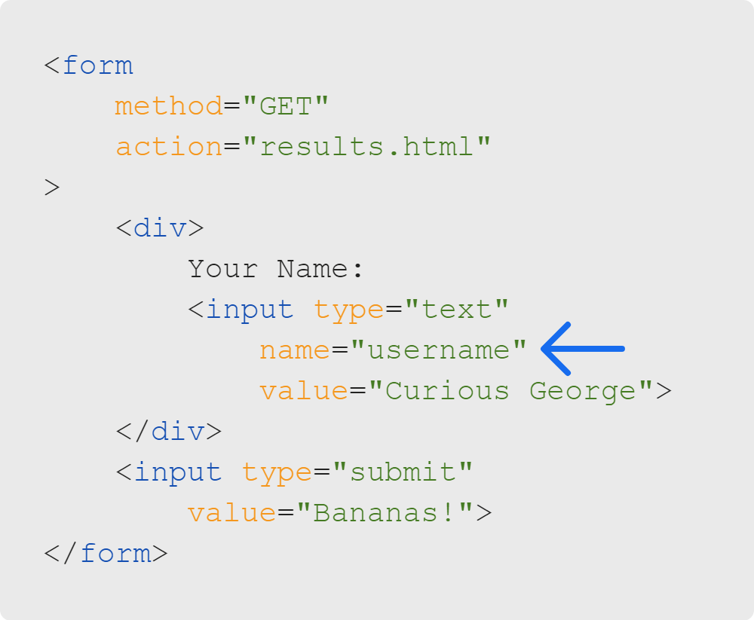


Introduction to Forms
Name Attribute
Code
Form
Receiving Page
Notes:
The "name" attribute is very important. It is how you tell the page receiving the form data what the
data is called. We'll be sending key-value pairs where the "name" attribute represents the "key" and
the data entered will be the "value."

Slide 15
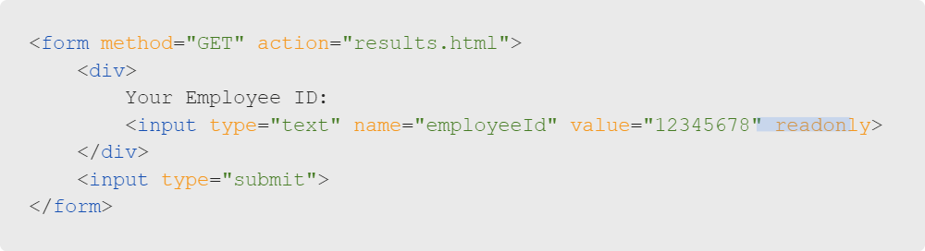
Introduction to Forms
Boolean Attributes
The only values are ON or OFF (presence means ON).
Readonly and checked are great examples.
Notes:
The "Boolean" attribute "readonly" makes this text input unable to be edited.
Similarly, the "Boolean" attribute "checked" on checkboxes or radio buttons will select them by default.

Slide 16
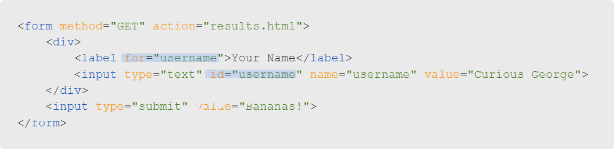
Introduction to Forms
Labels & Accessibility
A label's for attribute connects to the id of an input.
This helps screen readers understand how to prompt the user accessing your form.
Notes:
Remember, not everyone who uses the internet is experiencing it the same way you are.
A label connects the prompt to the "input" tag gathering the information. This way, screen readers
can interpret if the prompt is for a particular input.
<< Refer to LC exercise 4: Labels and exercise 5: Labels & the For Attribute >>

Slide 17

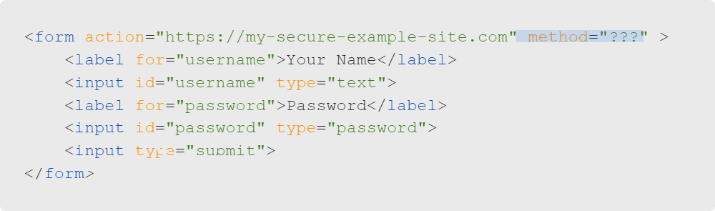
Introduction to Forms
Quiz: Let's Discuss
What HTTP verb would you choose for your form's method if you were sending a username and password combination?
A. GET
B. POST

Slide 18
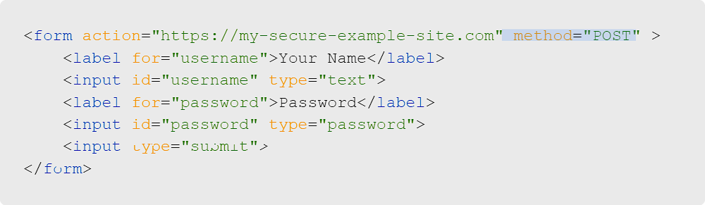
Introduction to Forms
Quiz: Multiple-Choice Answers
What HTTP verb would you choose for your form's method if you were sending a username and password combination?
A. GET
B. POST
Notes:
Definitely POST! Why? Because then the data isn't visible in the URL AND it will be encrypted when sent.

Slide 19

Introduction to Forms
Let's Get into It!
Ready to implement a sign-up form with all these input tags?
Notes:
Let's get some hands-on experience!

